Slide 1

Database Management Systems Course Code: CSE-2007
MODULE – 4
(SQL, Query Processing and Optimization)
By:
Dr. Nagendra Panini Challa
Assistant Professor, Senior Grade 2
SCOPE, VIT-AP University, India

Slide 2
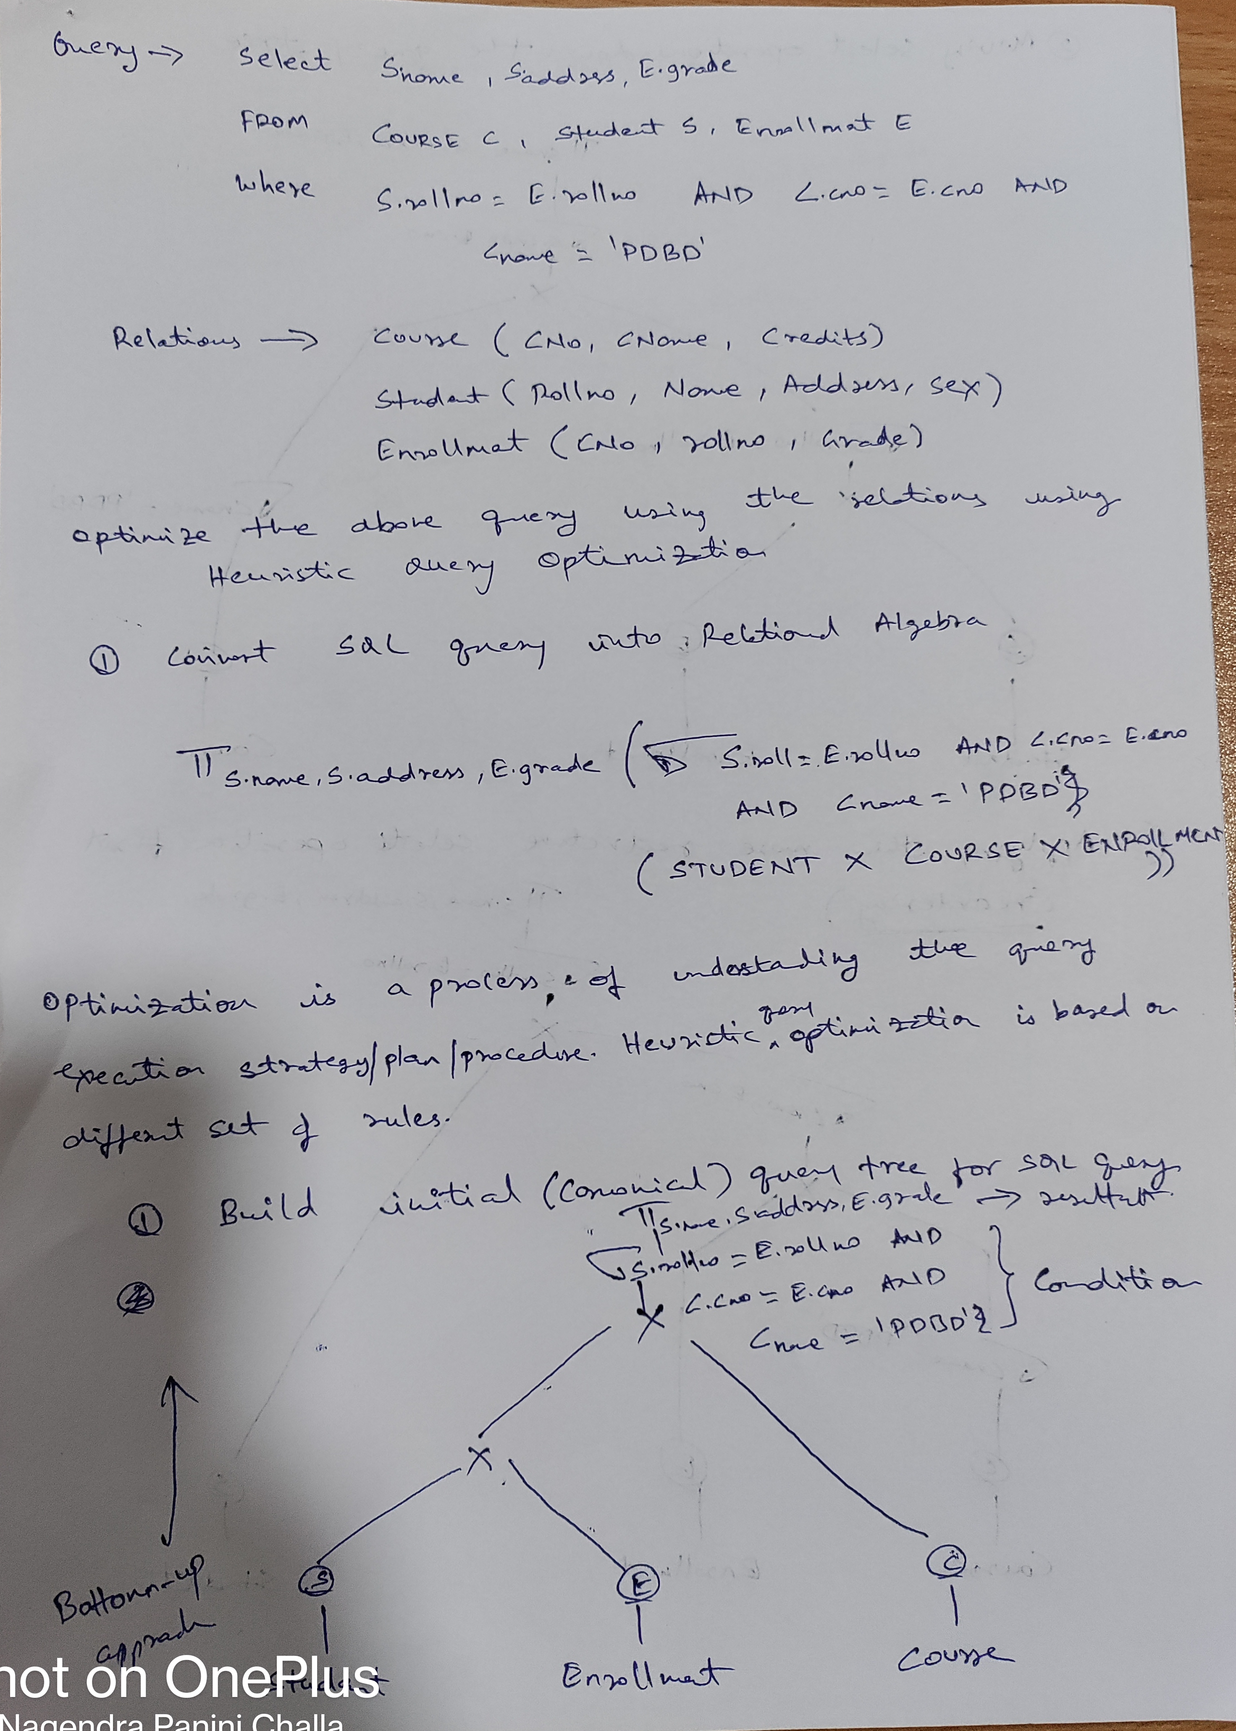
Query:
Select S.name, S.address, E.grade
FROM Course C, Student S, Enrollment E
Where S.rollno=E.rollno AND C.Cno = E.cno
AND Cname = ‘PDBD)
Relation Schemas
Course(Cno, Cname, Credits)
Student(rollno, Name, Address, Sex)
Enrollment(Eno, rollno, Grade)

Slide 3
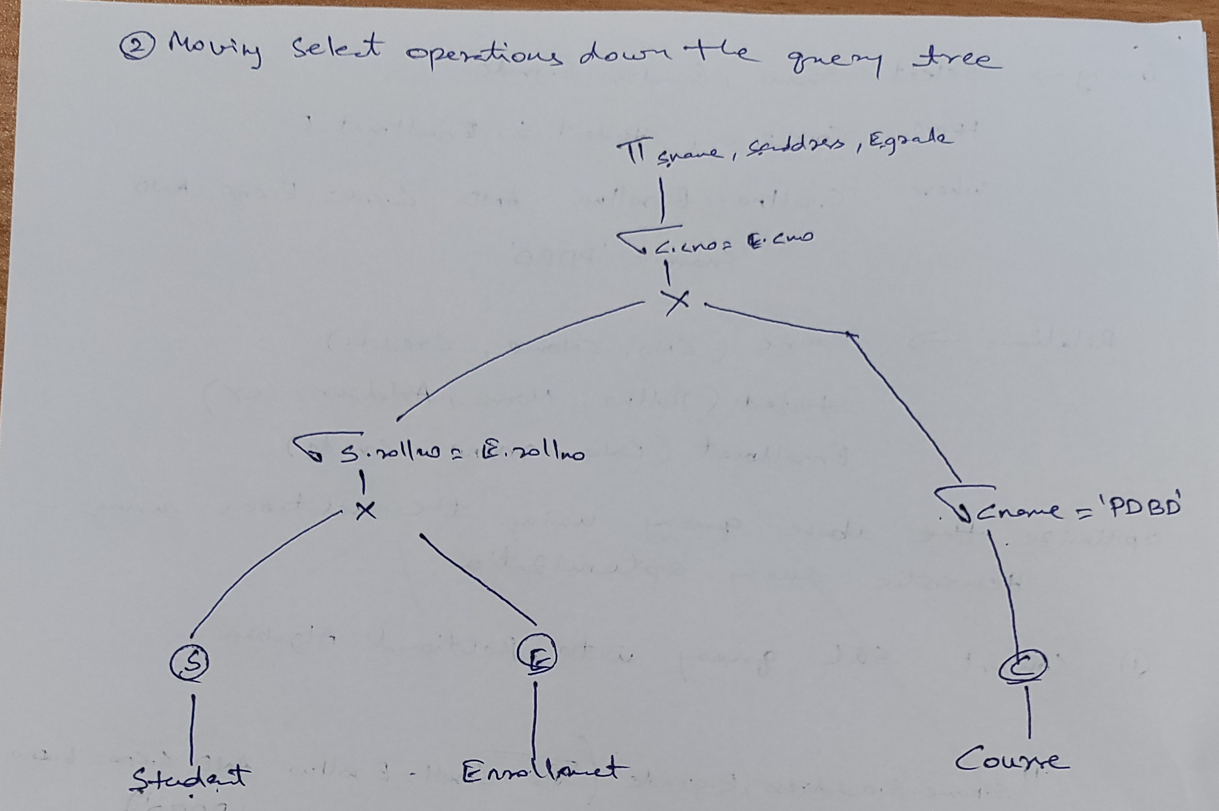
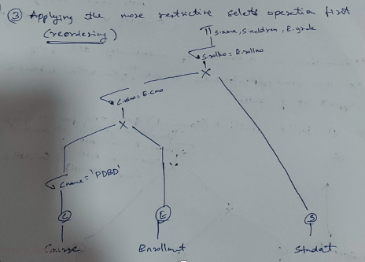

Slide 4
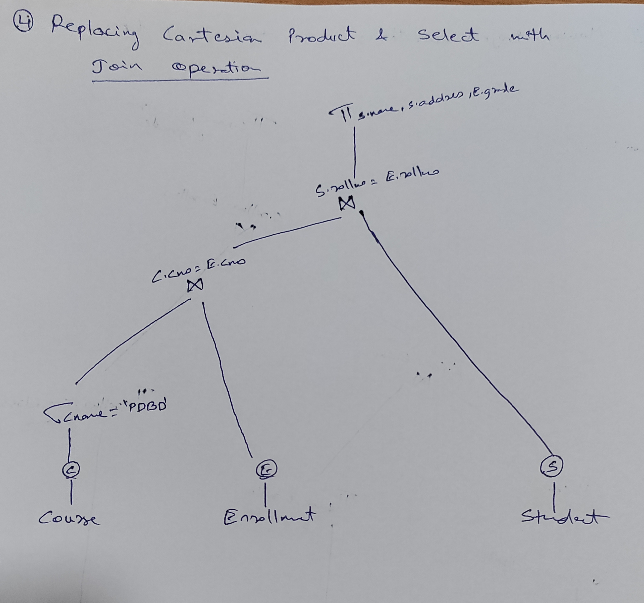

Slide 5
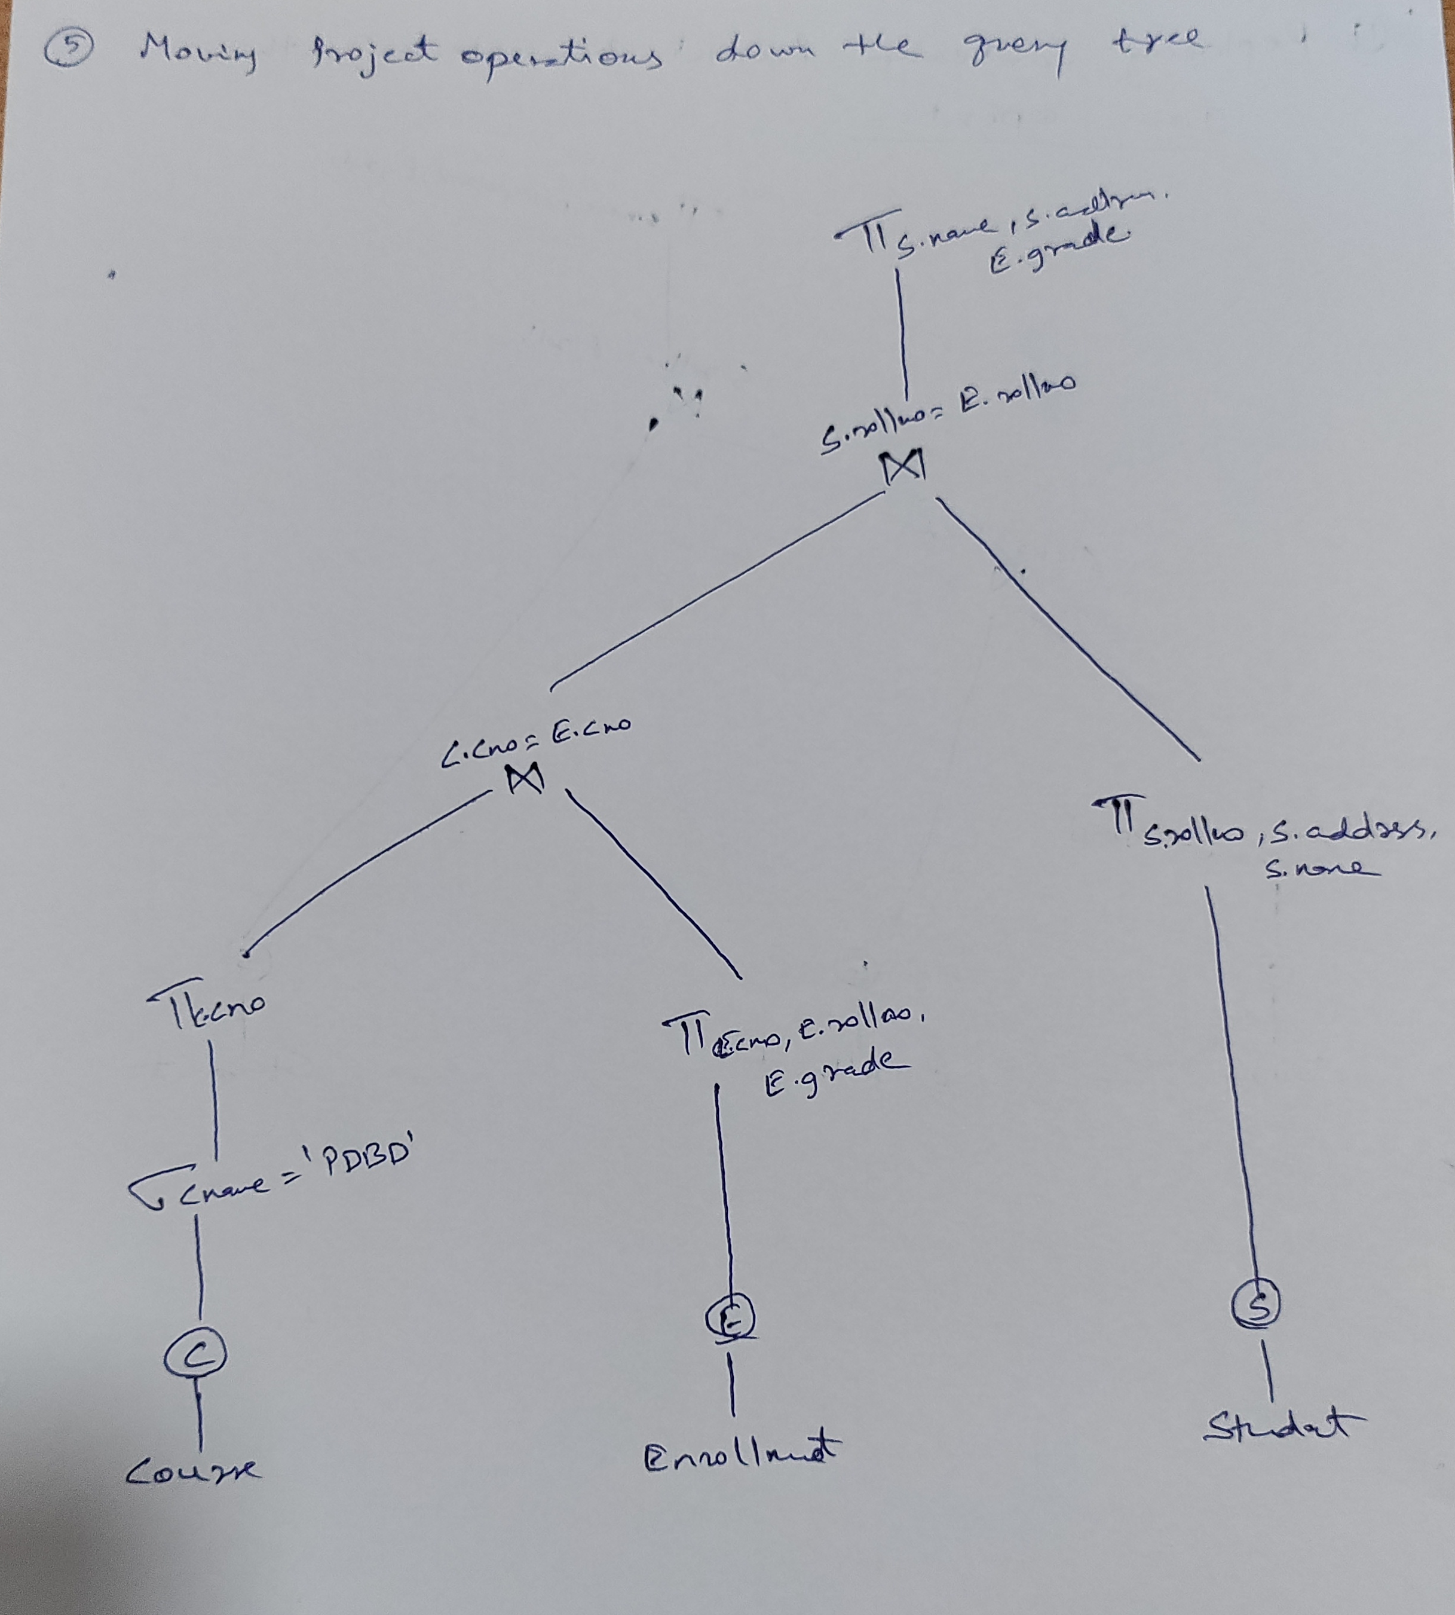

Slide 6
Example Problem
SELECT PNUMBER, DNUM, LNAME FROM PROJECT, DEPARTMENT, EMPLOYEE WHERE DNUM=DNUMBER and MGREMPID=EMPID and PLOCATION = 'Stafford’;
EMPLOYEE (FNAME, MI, LNAME, EMPID, BDATE, ADDRESS, Sex, SALARY, SUPERMPID, DNO)
DEPARTMENT (DNAME, DNUMBER, MGREMPID, MGRSTARTD)
PROJECT (PNAME, PNUMBER, PLOCATION, DNUM)

